Slide 1
Computational Physics
2018/1/19
24F17017 Shohei Goda

Slide 2
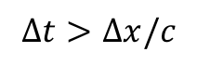
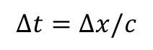
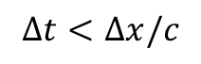
Advection wave equation by FTC scheme
$$∆t<∆x/c$$
$$∆t=∆x/c$$
$$∆t>∆x/c$$

Slide 3
Advection wave equation by Lax scheme
$$∆t<∆x/c$$
$$∆t=∆x/c$$
$$∆t>∆x/c$$

Slide 4
Advection wave equation by Lax-Wendroff scheme
$$∆t<∆x/c$$
$$∆t=∆x/c$$
$$∆t>∆x/c$$

Slide 5
Advection step equation by FTC scheme
$$∆t<∆x/c$$
$$∆t=∆x/c$$
$$∆t>∆x/c$$

Slide 6
Advection step equation by Lax scheme
$$∆t<∆x/c$$
$$∆t=∆x/c$$
$$∆t>∆x/c$$

Slide 7
Advection step equation by Lax-Wendroff scheme
$$∆t<∆x/c$$
$$∆t=∆x/c$$
$$∆t>∆x/c$$

